Slide 1





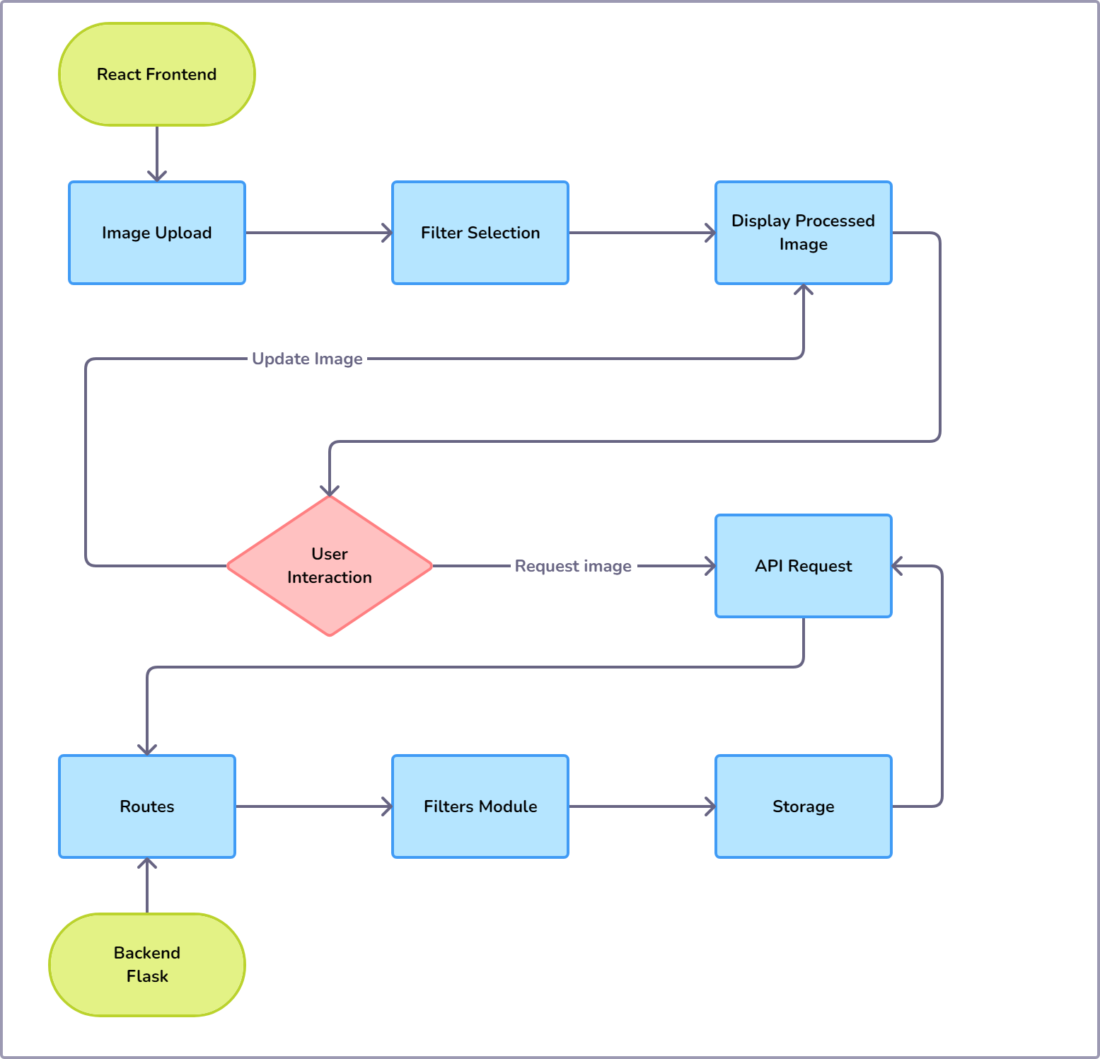
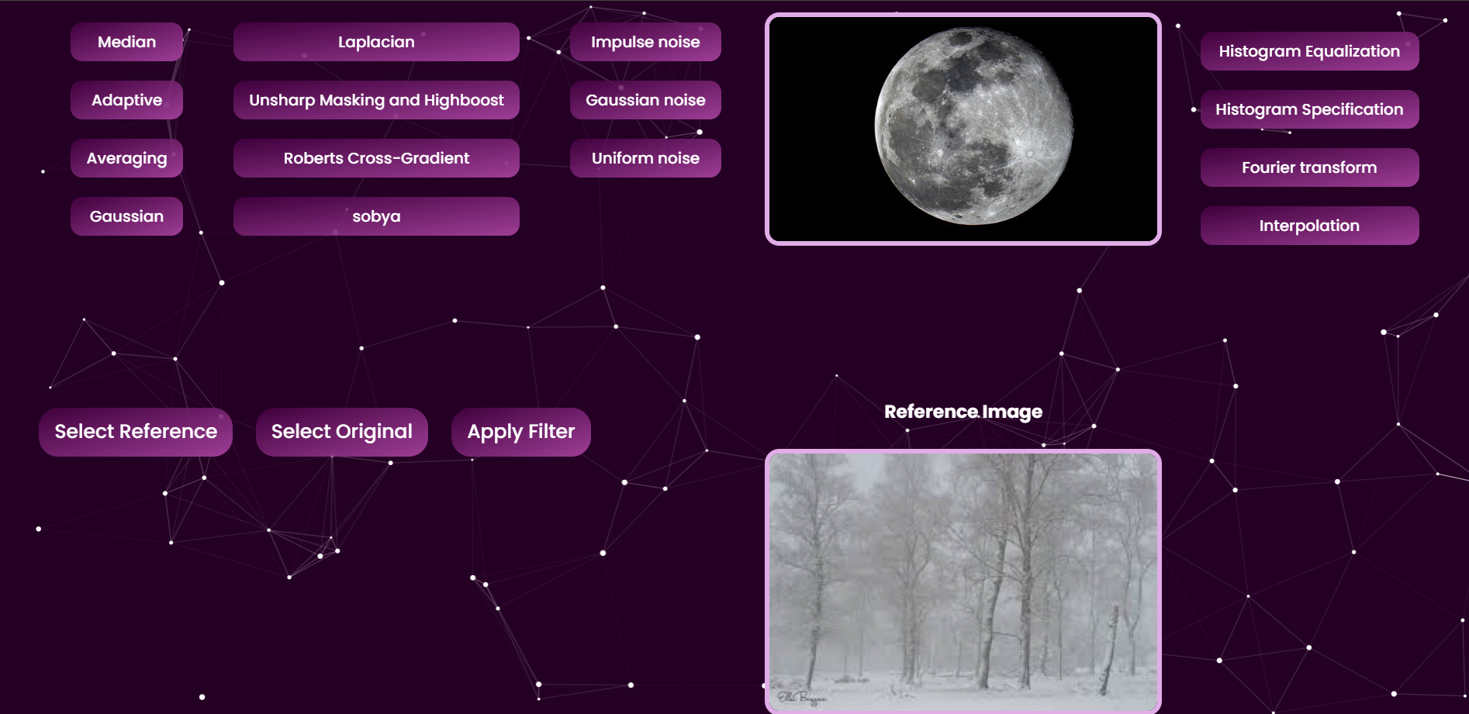
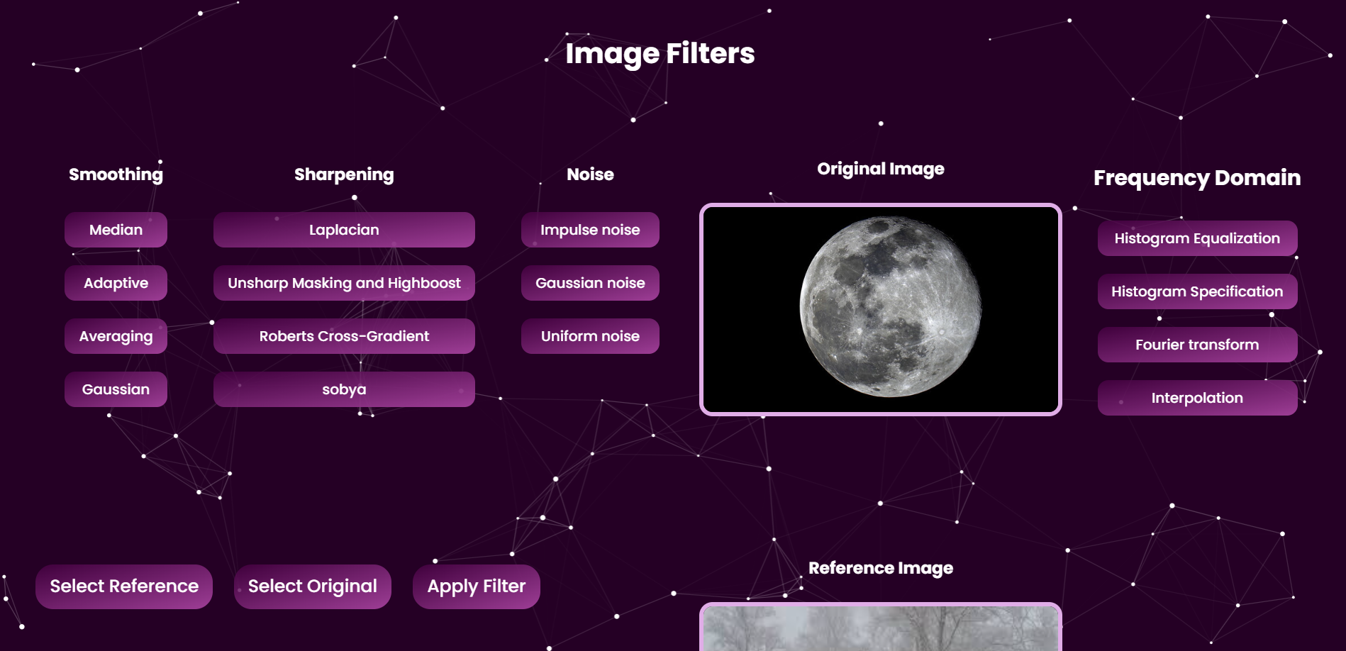







Image Filters
PROJECT ID: 3-10-01
Name: Fares Wael
ID: 224897
Course code: CS 389
Course Name: Digital Image Processing
Course Coordinator: Dr. Ehab Emam
Course TA: Habiba Mohammad
Name: Omar Ahmed Essam
ID: 222481
Name: Amr Khaled Akl
ID: 222869
INTRODUCTION
In the realm of digital image processing, filters play a crucial role in enhancing, transforming, and analyzing images. This project focuses on the development and application of various image processing filters to achieve specific visual effects and improvements. By implementing a range of filters, including smoothing, sharpening, edge detection, and noise reduction, we aim to explore their impact on image quality and feature extraction. The project not only delves into the theoretical underpinnings of these filters but also provides practical examples and applications, demonstrating their utility in fields such as photography, medical imaging, and computer vision. Through this comprehensive study, we aim to deepen our understanding of image processing techniques and their potential to revolutionize the way we interpret and manipulate visual data.
This project explores a variety of image processing filters from basic smoothing and sharpening to advanced techniques like edge detection and noise reduction. We focus on practical applications, demonstrating their impact across photography, medical imaging, and computer vision. Additionally, we integrate advanced methods such as Fourier transforms, histogram equalization for contrast enhancement, and Huffman compression for efficient data storage and transmission. Join us as we delve into the world of image processing, uncovering its potential to enhance and interpret visual data across different fields.
SYSTEM UI
RESULTS
Noise Reduction and Image Clarity:
Smoothing filters significantly reduced noise, enhancing overall image clarity.
Essential details were preserved, leading to clearer, more precise images.
Enhanced Feature Definition:
Sharpening filters improved edge definition, making fine details more pronounced.
Edge detection filters, such as Sobel, Laplacian, and Roberts Cross effectively highlighted boundaries for more precise image analysis.
Astronomical Image Enhancement:
Filters enhanced the visibility of celestial bodies and structures within astronomical images.
Improved image quality facilitated better interpretation and analysis of astronomical data.
Medical Imaging:
Filters contributed to clearer and more accurate medical images, aiding in diagnosis and treatment planning.
Enhanced feature extraction helped in identifying critical details in medical scans, such as tumors and tissue structures.
SYSTEM UI
CONCLUSION
TOOLS
CONTACTS
The application of various image processing filters demonstrated substantial improvements in image quality, feature extraction, and analysis across multiple domains. Noise reduction filters enhanced image clarity, while sharpening and edge detection filters improved detail and boundary definition. In astronomy, these techniques significantly enhanced the visibility and analysis of celestial bodies, contributing to more accurate measurements and discoveries. Similarly, in the medical field, the improved image quality and feature extraction supported better diagnosis, treatment planning, and advanced research. Overall, the results underscore the vital role of image processing filters in enhancing visual data interpretation and analysis across diverse applications.
Omar Ahmed
Fares Wael
Amr Akl

